Slide 1
Marketing Insights
Provide Insights to the Marketing Team in Food & Beverage Industry
By Pranoti Malgunkar

Slide 2
Agenda
Introduction
Task
Insights and Recommendation's
Suggestions

Slide 3
Introduction
CodeX is a German beverage company that is aiming to make its mark in the Indian market. A few months ago, they launched their energy drink in 10 cities in India.
They conducted a survey in those 10 cities and received results from 10k respondents. Marketing data analyst have tasked to convert these survey results to meaningful insights which the team can use to drive actions.

Slide 4
Task
We work as Marketing data analyst. We have tasked to convert these survey results to meaningful and actionable insights for CodeX Chief Marketing Officer.

Slide 5
Main Goals
Increase Brand Awareness
Increase Market shares
Identify target consumers
Product development

Slide 6
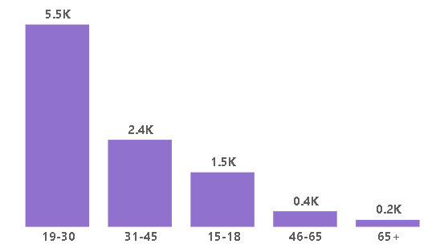
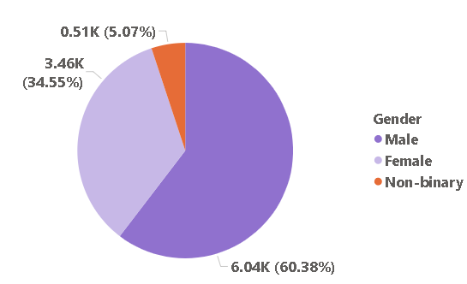
Insights And Recommendation's
19–30 age group accounts for approximately 56% of total energy drink consumption.
60% consumers are male

Slide 7
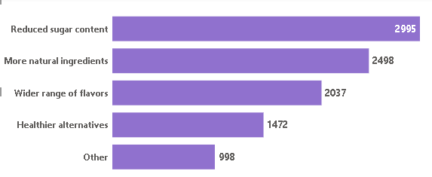
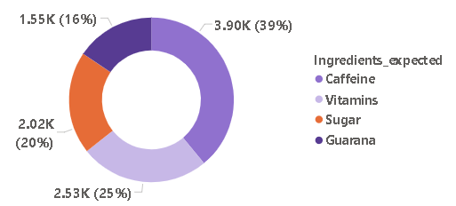
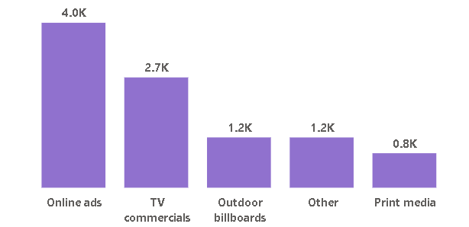
Online advertising is the most effective channel, reaching the majority of young consumers.
Approximately 49% of the audience reached through online ads falls within the 19–30 age group.
TV commercials account for 32% of the reach.
Caffeine(39%) and vitamins(25%) are most preferred ingredient.
Consumer express a preference for reduced sugar content and the inclusion of more natural ingredients in energy drinks.

Slide 8
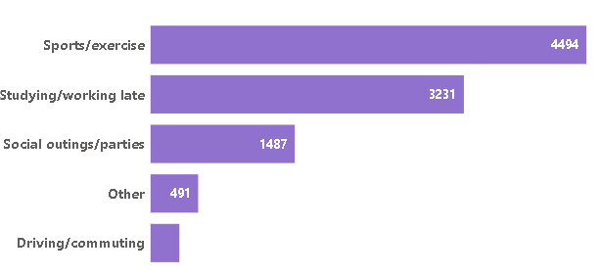
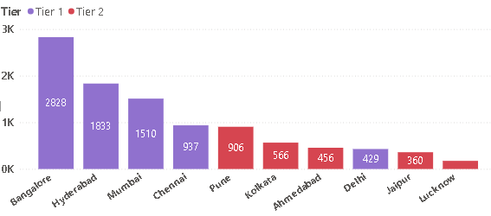
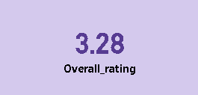
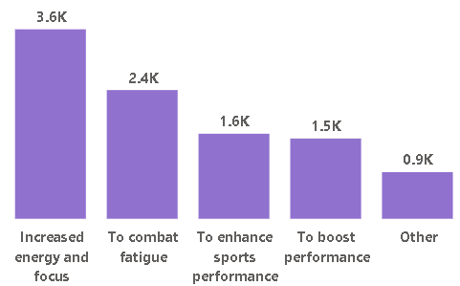
GOOD..
Customers primarily consume energy drinks for sports/exercise and studying or working late so that they increased energy and focus.
Most of consumer doesn’t know about energy drink.
Need to focus on Tier2 cities.

Slide 9
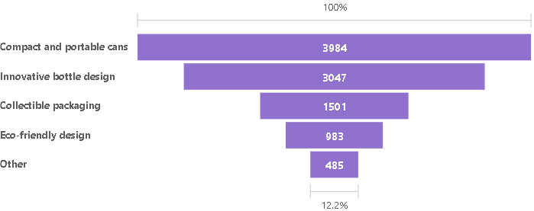
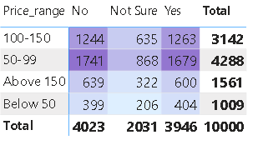
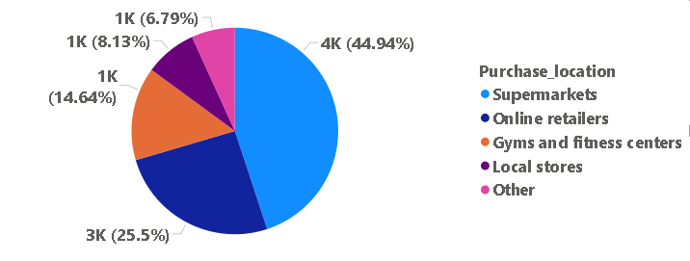
Most of consumer purchase product from Supermarket.
Approximately 40% od consumers prefer compact and portable cans, while 31% express a preference for innovative bottle design.
Price range preferred between 50-150.

Slide 10
Suggestion for improvement
Availability of product
Health concern
Limited Edition Packing
Add more natural ingredients, reduce sugar content and add more flavours.
Improve Positive Response rate

Slide 11
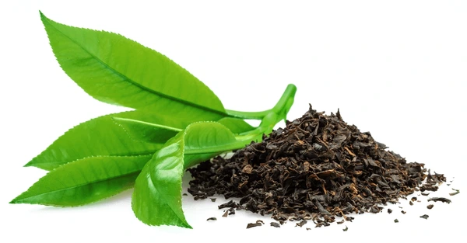
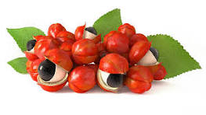
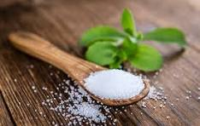
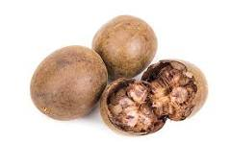
Green tea : provides a natural source of caffeine with L-theanine, offering smooth and focused energy without jitters or crashes.
It’s rich in antioxidants like EGCG, which support metabolism, heart health, and overall wellness.
.
Guarana : Natural caffeine source for sustained energy and mental alertness
.
Stevia is a natural, zero-calorie sweetener making it ideal for reducing sugar without losing sweetness.
It helps maintain stable blood sugar levels and supports healthier, low-calorie beverage options.
.
Monk fruit : is a natural, zero-calorie sweetener offering sweetness without raising blood sugar levels.
It’s rich in antioxidants and is a popular choice for creating healthier, low-sugar drinks.
.

Slide 12
Price and Packing Design
Small packs: Priced up to ₹100 – affordable for budget-conscious or occasional buyers.
Large packs (cans): Priced up to ₹150 – ideal for regular consumers or family use.
Content-based pricing to meet varied customer needs Tiered pricing increases accessibility and supports wider market reach.
Approximately 40% of consumers prefer compact and portable cans, while 31% express a preference for innovative bottle design.
Recommend offering both packaging options initially and monitoring consumer preferences over time to scale up production for the more popular format.
special discounts on 6-can packs during festivals or bulk purchases to drive higher sales.

Slide 13
Suggestion for marketing campaigns
Social Media :Post fun and interesting content on Instagram, TikTok, or X to reach more people and make your brand popular.
Email marketing :Send emails with tips, offers, or updates to keep customers interested and buying again.
Influencer Marketing : Work with small influencers who your audience follows to promote your drink in a trusted way.
Guerilla Marketing : Use creative, low-cost ideas like pop-up stalls or contests to get people’s attention locally. Also strengthen partnerships with local supermarkets for increased visibility and availability.

Slide 14
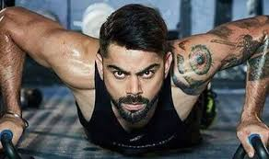
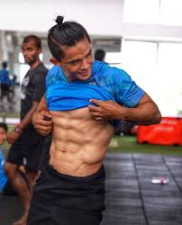
Suggestion for brand ambassador
Virat Kohli
Virat is a Youth Icon and famous for his discipline towards his game and fitness. Almost every person is follow his style of living.
He has 256M followers (Instagram) social Media.
Partnering with him can be costly
Sunil Chhetri
Sunil Chhetri is a Football Legend and famous for his dedication, discipline, and fitness. He is an inspiration for young athletes and football fans across India.
He has 8M+ followers on Instagram and a strong social media presence.
Partnering with him can be moderately costly but highly impactful for sports and energy-related brands.

Slide 15
Suggestion for Target audience
Target Audience
CodeX energy drink primarily targets men aged 19–30, who lead active lifestyles and seek products that boost energy and performance

Slide 16
THANK YOU….

